Slide 1
M2 - Alternative Solutions
By Usman Basharat
Unit 11 – Software Analysis and Design
S1300173

Slide 2

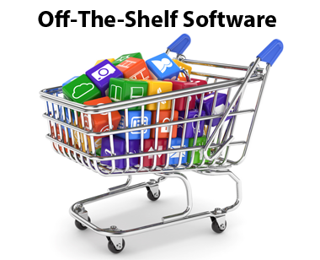
Introduction
For this presentation, I will define ‘Off the shelf’ software and bespoke system. I will name the advantage and disadvantage for each of them. Lastly, I will compare both of them.

Slide 3
‘Off the shelf’ Software
‘Off the shelf’ software is a software that is ‘readymade’. This means that all the programming, logo, design is complete. All you need to do is go to the shop and purchase it and you can use it already. Some examples of ‘Off the shelf’ software is Microsoft Office, Norton, Visual Basics and many more. They are many programmes that are ‘readymade’. In addition, they are used in schools, offices, home, and any place that you can think of.

Slide 4
Advantage
Easy to use
No time needed
Cost is cheap depending on which version and software you want
Any errors can be erased by contacting the company for issues on the program
Sharing files is easy

Slide 5
Disadvantage
Some programmes are expensive e.g. Adobe Photoshop costs above £200.
If the user is not similar with the software, he/she needs to learn how to use it.
Some facilities that an average user uses is 10%, the other they may not know. Some features are hard to use on some programmes.
As it is readymade, you may need to make changes to the programme to make it easy for the candidate to use.

Slide 6
Bespoke System
“Bespoke software can take you where off-the-shelf cannot. It will, by definition, be a perfect match to your needs, and it can change and grow with you.”
‘Bespoke’ means it is made by itself. Bespoke system is started from the bottom and it makes it’s way up. This means the user has to follow each step by planning, analysing, installing, and maintaining it. Whatever you want for the system, you can change it because it is designing by you. A person cannot create it himself. He needs a team for it to create a bespoke system. They all needs to participate, know what their aim is to do and follow the steps of it.

Slide 7
Advantage
Flexible – you can change the way want it to be. Even specific coding and the layout.
Unique – it could be very different to the other software's that is out there. More programmes are the same of another and they can make it different to equal more profit for the organisation.
As you are the ‘owner’, you can erase errors for any to come.
Better information gathered – they are many companies that have completed this stage. You can ask them and implement or gain ideas for your programme.

Slide 8
Disadvantage
Time – you have to take time out day in and out for the programme to be complete. They is a specific process the user/s follow for it to be done.
Complex – it is hard to do if you want to make something big, you need more than one expert in each field to complete it.
Quality – the package that is purchased needs to be quality for it to be better long term. They are benefits and drawbacks of each package.
Even once the programme’s complete, you need to maintain and test the programme for it to erase any forgotten errors.

Slide 9
Comparison
Having a bespoke system could put at a competitive advantage. More people would want a programme that is unique and you can ask customers of what they want for a new software and use them ideas. This could result in the company making more money than others. However, ‘Off the shelf’ software does not take time for you to create. You can purchase it whenever you want and you can use it when you want. In addition any errors or help you need, you can ask the companies employees for help. Unlike bespoke, you have to erase the errors yourself.

Slide 10
Reference
http://www.bcs.org/content/ConWebDoc/2767
http://www.teach-ict.com/gcse_computing/ocr/213_software/custom_offshelf/miniweb/pg2.htm

